Slide 1

Surety Bonds

Slide 2
Agenda
What is Surety?
Cases
Process: How does it work?
Insurance Vs Surety
Types of Surety
Related Documents & Forms in Surety
A Look at CapSpecialty Surety & Fidelity offering

Slide 3
Course Outline
Day 1
What is Surety?
Surety Process: How does it work?
Types of Surety
Insurance Vs Surety
Surety Glossary
Day 2
Related Documents & Forms in Surety
CapSpeciality: Surety & Fidelity offering

Slide 4
Surety Documents
Contract Bond Documents
Bank Reference Letter
Bid Bond Request
Bond Kit Cover Letter
Bond Kit Portfolio
Bid Results Form
Business Plan
Contractor Questionnaire
Customer Satisfaction Survey
Express Mail Agreement Form
Fast Track Application
Frequently Asked Questions
Job Cost Breakdown
Payment Performance Bond Request
Personal Financial Statement
Reference Letter
Resume
Supplier Reference Letter
Work on Hand
License & Permit Documents
Additional Indemnitor Application
Change of Address Form
Change of Business Name Form
Credit Card Authorization
Customer Satisfaction Survey
Generic Application
Georgia Lost Title - T4 Document
Georgia Lost Title MV-46A
Georgia Lost Title T-22B
ILOC - Sample Form
Personal Financial Statement
Resume
Rider Credit Card Authorization

Slide 5
Surety Documents
Court Bond Documents
Administrator Underwriting Review Sheet
Appeal (Defendant) Bond Application
Conservator-Guardian of a Minor Bond Application
Conservator-Guardian of an Incapaciated Adult Bond Application
Special Needs Trust Bond Application
Customer Satisfaction Survey
Agent Documents
Agency Questionnaire
Agent of Record Letter
Generic Application
Fast Track Application
W-9 Form

Slide 6
License & Permit Documents
Additional Indemnitor Application
An individual or company who agrees to assume the obligation normally placed on a surety if the per a bond was issued on defaults. This is usually done because the applicant does not qualify as an acceptable risk by the surety's standards
(Day to day related Example : Guarantor in case of Loan sanction, who assumes the losses if the person who takes the loan becomes defaulter.)
Surety Bond Application
Personal Financial Statement
Change of Address Form
Letter of Credit

Slide 7
Contract Bond Document
Bank Reference Letter
Customer Satisfaction Survey
Work on Hand
Supplier Reference Letter

Slide 8
Court Bond Documents
Conservator-Guardian of a
Minor Bond Application
Administrator Underwriting
Review Sheet
Appeal (Defendant) Bond Application
Customer Satisfaction Survey

Slide 9
Agent Documents
Agency Questionnaire
Agent of Record Letter
Generic Application
W-9 Form

Slide 10
Overview of the 25 Largest Surety Bond Companies in the United States
Overview of the 25 Largest Surety Bond Companies in the United States
Company Name | Written Premiums | Market Share | Loss Ratio
Travelers Group | 991,622,397 | 18 | 9
Liberty Mutual Insurance Group | 832,837,018 | 15.1 | 19.5
Zurich Insurance Group | 482,534,915 | 8.8 | 7.1
CNA Insurance Group | 434,336,484 | 7.9 | 17.1
Chubb & Son Group | 297,286,287 | 5.4 | 36.4

Slide 11
CapSpecialty
CapSpecialty, Inc. is an insurance holding company. It operates as a subsidiary of Alleghany Insurance Holdings, LLC.
It writes specialty lines of P & C insurance as well as fidelity and surety coverages,
It writes through its subsidiary, Capitol Indemnity Corporation (CIC).
CIC operates in 37 states with a geographic concentration in the Midwestern and Plains States.
CIC conducts business through independent and general insurance agents located throughout the United States.
CapSpecialty offers a full inventory of specialty lines, including commercial property, casualty, fidelity, surety and professional lines.
They have both admitted and non-admitted capabilities. Their collaborative approach keeps them in step with ones needs and those of his customers.
CapSpecialty offers a full suite of fidelity and surety products:
CapSpecialty® | Express
Commercial Surety
  Commercial Contract Surety
  Fidelity
Construction Contract Surety

Slide 12
Forms & Application Search

Slide 13
CapSpeciality Express
CapSpecialty offers a full suite of fidelity and surety products:
CapSpecialty® | Express :
  Automated online Surety & Fidelity underwriting system for both new and renewal business. Facilitates agents to continually enhance the "ease of doing business" with CapSpecialty. CapEx offers access to rates, quotes, bond issuance, and billing of transactional commercial surety and fidelity bonds. It is also a channel to view reports on all of the bond business with CapSpecialty.
CapSpecialty Express has many features including:
  Instantaneous issuance and automatic reporting of bonds
  Quick quoting capability for probable premium without making a full submission
  Save and view submissions in a pended status
  Automated referrals to Underwriters or their non-standard program agent
  Reports available for management of all CapSpecialty bond business
  Multiple bonds allowed per bond applicant with an aggregate up to $75,000 (subject to bond type)
  Billing options for both Direct and Agency Bill
  Ability to view upcoming renewals
  Automated renewals of all CapEx eligible bonds
  Standard commission on automated underwriting bond business is 35%
CapSpecialty® | Express
Commercial Surety
  Commercial Contract Surety
  Fidelity
Construction Contract Surety

Slide 14
Commercial Surety :
CapSpecialty® | Express
Commercial Surety
  Commercial Contract Surety
  Fidelity
Construction Contract Surety
Commercial Surety :
CapSpecialty's expert commercial surety underwriting team writes a full range of bonds in each of these areas:
  Commercial Contract
  Fiduciary
  Judicial
  License and Permit
  Public Official

Slide 15
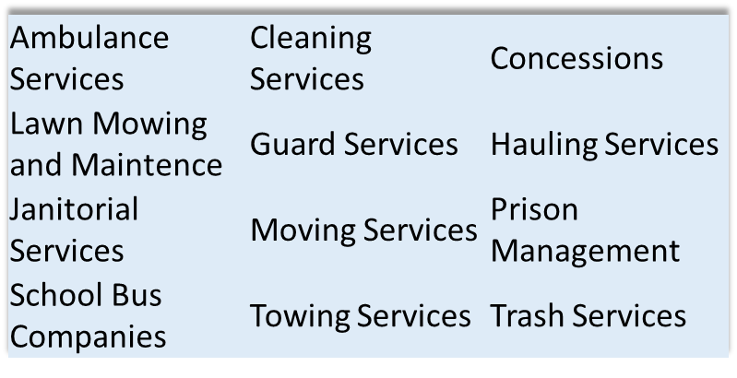
Commercial Contract Surety
  Commercial Contract Surety:
  “non-typical” Commercial Contract
  Contract Surety has traditionally meant construction of Buildings, Bridges, Tunnels, Streets and Highways.
CapSpecialty® | Express
Commercial Surety
  Commercial Contract Surety
  Fidelity
Construction Contract Surety
  Serving Contracts
Supply and Installation (Installation no greater than 50% of contract)
Supply Contracts (off the shelf, non proprietary)
Alarm Installation
Fencing Supply and Installation
Sprinkler System Supply and Install
Audio/Visual Contracts
Books and School Supplies
Fuel Oil
Automobiles

Slide 16
FIDELITY
Fidelity coverage (also called “Employee Dishonesty”):
Indemnifies employers against loss resulting from the dishonest acts of their employees and
is needed by:
  Churches and other religious organizations,
  colleges, schools,
  municipal entities including cities, counties and towns;
  fraternal orders (American Legion, Boy Scouts);
  lawyers, accountants, doctors,
  insurance and real estate agents
  and virtually any business where the owner must trust employees with money,
  records or merchandise.
CapSpecialty® | Express
Commercial Surety
  Commercial Contract Surety
  Fidelity
Construction Contract Surety

Slide 17
Construction Contract Surety
Construction Contract Surety :
Small Contract Program is based soley on personal Credit. Program limits are
$350,000 Single/$500,000 Aggregate
CapSpecialty is in an excellent position for a small contractor credit based
program because of:
  CapSpecialty’s Fidelity and Surety agency relationships,
  product knowledge,
  commercial surety penetration,
  existing systems and infrastructure
Target Market:
  Construction Contractors
  General Contractors
  HVAC
  Electrical
  Excavation
  Landscaping
  Masonry
  Sewers
  Roofing
CapSpecialty® | Express
Commercial Surety
  Commercial Contract Surety
  Fidelity
Construction Contract Surety

Slide 18
Suggested Readings
Surety Bonds Documents :
http://suretybondsagency.com/surety-bond-documents
How does Surety Bond Work:
https://www.oxbonding.com/blog/how-do-contract-surety-bonds-work/

